Slide 1
Die Regeln (Rules)
Object of the game:
To find out which animals pupils are hiding using animal words and ein, eine, einen, kein, keine, keinen.
How to play:
The teacher chooses 5 people to stand up and hold up (but hide!) a card with a picture of an animal on it.
The teacher throws a ball to someone else in the class.
The person with the ball asks anyone with a picture whether they have a particular animal.
The person with the card replies in a full sentence.

Slide 2
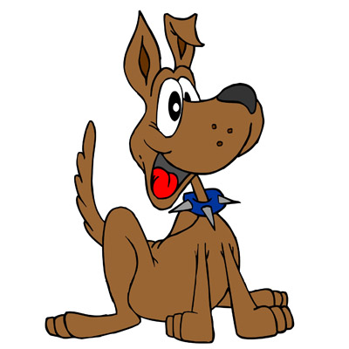
Points for:
Asking a question correctly
Answering a question correctly
If you ask the question correctly, throw the ball to another person in the classroom.
If you don’t ask correctly, give the ball back to the teacher.
If you have a card and someone guesses your animal, you sit down.
The game ends when all of the animals have been guessed correctly.

